Slide 1
Pink Quiz

Slide 2
Question 1
What is the te reo Māori word for pink?

Slide 3
Question 2
True or false:
The first Pink Shirt Day was held in Aotearoa in 2011

Slide 4
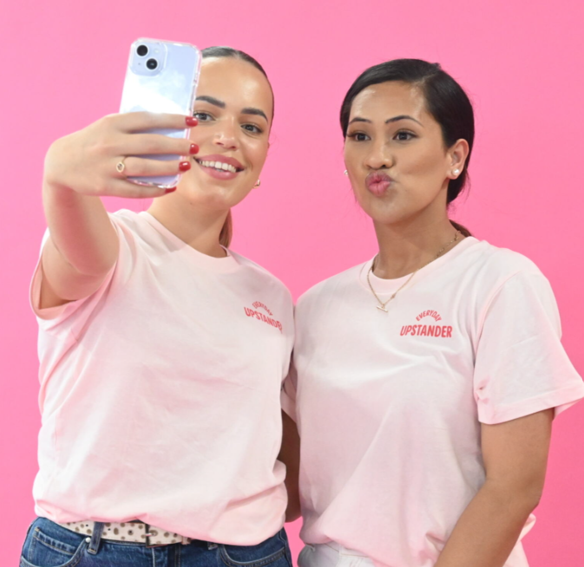
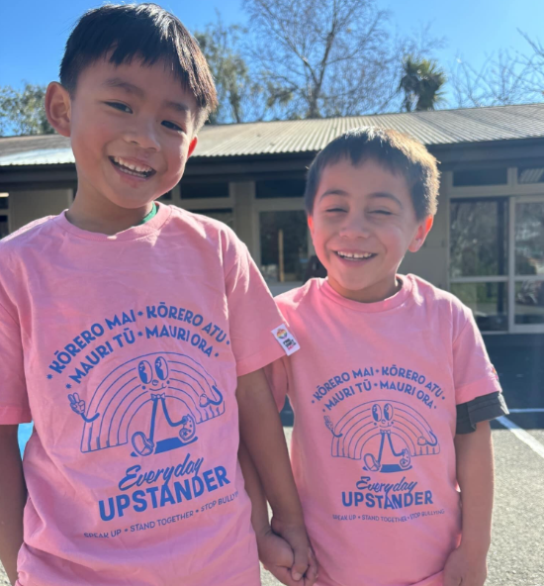
Question 3
Name the year that each of the official Pink Shirt Day t-shirts pictured below were released
(one point for each correct answer)
A.
B.
C.

Slide 5
Question 4
True or false:
The name of the official Pink Shirt Day waiata is Iarere Āio

Slide 6
Question 5
True or false:
Pink Shirt Day began in Aotearoa

Slide 7
Question 6
Who sang the lead single, Dance the Night, in the Barbie movie?

Slide 8
Question 7
Which iconic pop star was known for her bold pink hair early in her career?
A) Lady Gaga
B) P!nk
C) Taylor Swift

Slide 9
Question 8
What pink animal stands on one leg?

Slide 10
Question 9
Cherry blossoms, known for their beautiful pink flowers, are the national flower of which country?
A) Japan
B) Aotearoa
C) Australia
D) Thailand

Slide 11
Question 10
What sweet treat made from coconut is coloured pink and white?

Slide 12
Answers
The te reo Māori word for pink is Māwhero
False: The first Pink Shirt Day was held in Aotearoa in 2009
A) 2023 B) 2021 C) 2024
True: The name of the official Pink Shirt Day waiata is Iarere Āio
False: Pink Shirt Day began in Canada in 2007 when two students took a stand against homophobic bullying after a new student was bullied for wearing pink.
Dua Lipa sang ‘Dance The Night’ in the Barbie movie
B) P!nk was known for her bold pink hair early in her career
A flamingo stands on one leg
A) The cherry blossom is the national flower of Japan
Coconut Ice is the sweet treat made from coconut and is coloured pink and white

