Slide 1


Pink Quiz

Slide 2


What is the te reo Māori word for Pink?
1

Slide 3
When was the first Pink Shirt Day held in Aotearoa?
2

Slide 4
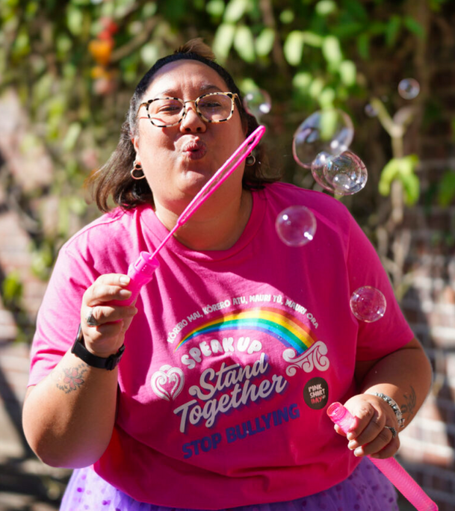
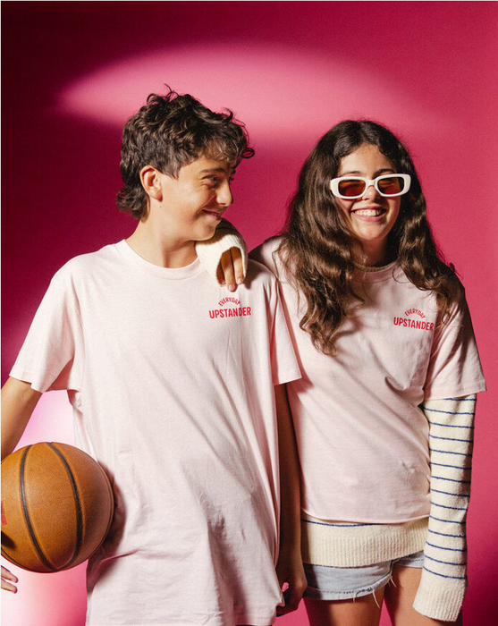
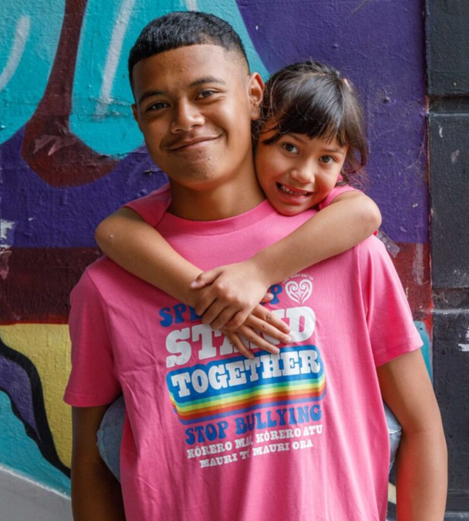
Name the year that each of the official Pink Shirt Day t-shirts pictured below were released
(one point for each correct answer)
A.
B.
C.
3

Slide 5
What is the name of the official Pink Shirt Day waiata?
4

Slide 6
In what 2023 movie does the colour pink prominently feature?
5

Slide 7
In most European languages what is the word for 'pink'?
6

Slide 8
Who sings the song ‘Cover Me In Sunshine’?
7

Slide 9
Carotenoids in plankton are responsible for
the pink feathers of what bird?
8

Slide 10
In which river would you find pink dolphins?
9

Slide 11
What sweet treat made from coconut is coloured pink and white?
10

Slide 12

Answers
  The te reo Māori word for pink is Māwhero
  The first Pink Shirt Day was held in Aotearoa in 2009
  A) 2022, B) 2023, C) 2021
  The name of the official Pink Shirt Day waiata is Iarere Āio
  The 2023 movie in which the colour pink features prominently is Barbie
  In most European languages the word for 'pink' is rose or rosa
  Pink sings the song ‘Cover Me In Sunshine’
  Carotenoids in plankton are responsible for the pink feathers in flamingos
  You would find pink dolphins in the Amazon River
  Coconut Ice is the sweet treat made from coconut is coloured pink and white

